Slide 1

eCommerce Behavior
Group 4
Jesus Barba, Lawrence Cho, Heriberto Corona, Luis Rodriguez, Freddy Romero

Slide 2
Introduction
The dataset shows the eCommerce behavior data from a multi-category store.
Dataset retrieved from Kaggle by Michael Kechinov
Data retrieved from Open CDP Project
Shows the purchasing power from consumers
Involves Hadoop and Beeline to contain and analyze the eCommerce dataset.
This dataset was chosen because we are daily consumers. We want to see which items are the most popular and if we can relate to them in any way.

Slide 3
Why is this dataset important?
Businesses can see which products are the most popular
Benefit new businesses
Create a niche product or follow a current trend
Seeing a trending in time can show when businesses want to release their products
Rather sell in prime time rather rather than inactive time
See if the eCommerce site is performing well overall
Help create reports to share to their investors

Slide 4
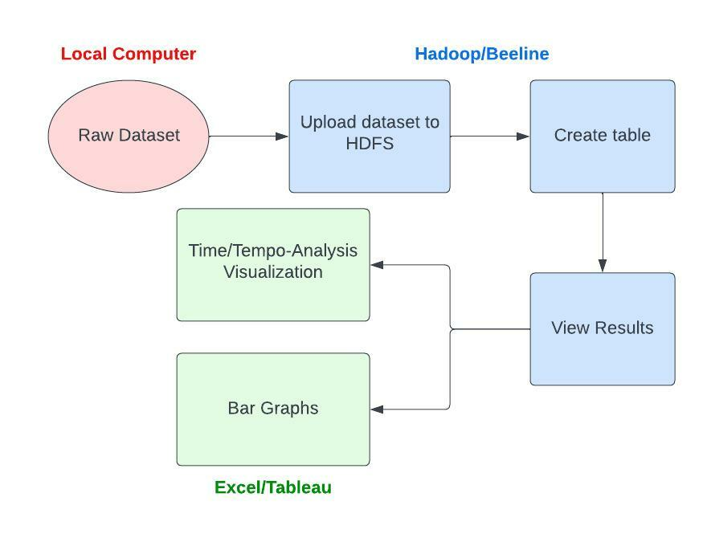
Implementation Flowchart
Diagram on the right shows the outline of the process
Since the data was downloaded as a .csv file, it removes the step of creating a smaller portion of the data and exporting it

Slide 5

Data Cleaning
The dataset did not need any data cleaning
The data was already organized and labeled appropriately
There were a few missing values, but this can be ignored
This makes sense because the dataset is focused on eCommerce behavior, so it is possible that consumers just visited the online shopping website and did not interact with it.

Slide 6
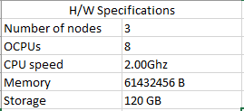
Specifications
Contains 5.5 GB of data within October 2019
The table below shows the specifications for Oracle cluster and Hadoop specification for this project

Slide 7
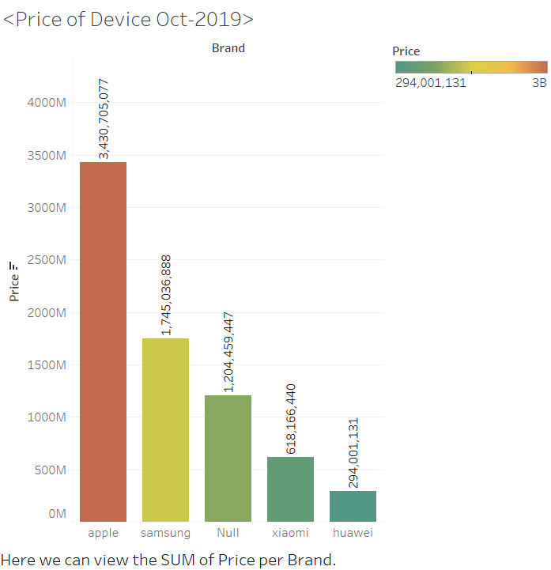
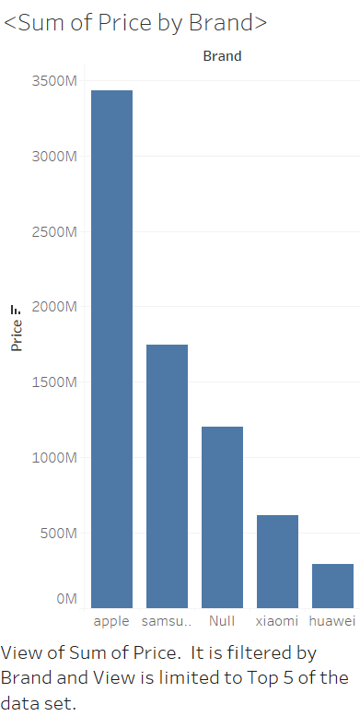
Data Analysis/Visualization

Slide 8
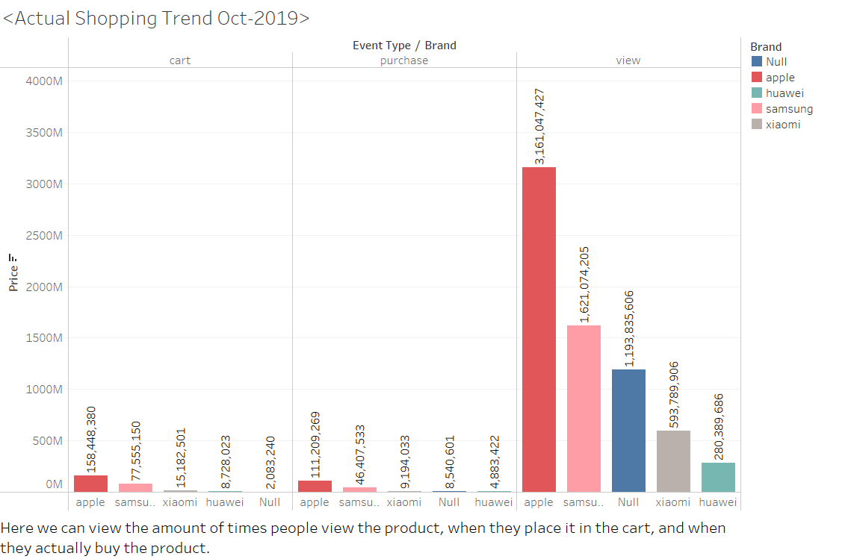
Data Analysis/Visualization

Slide 9
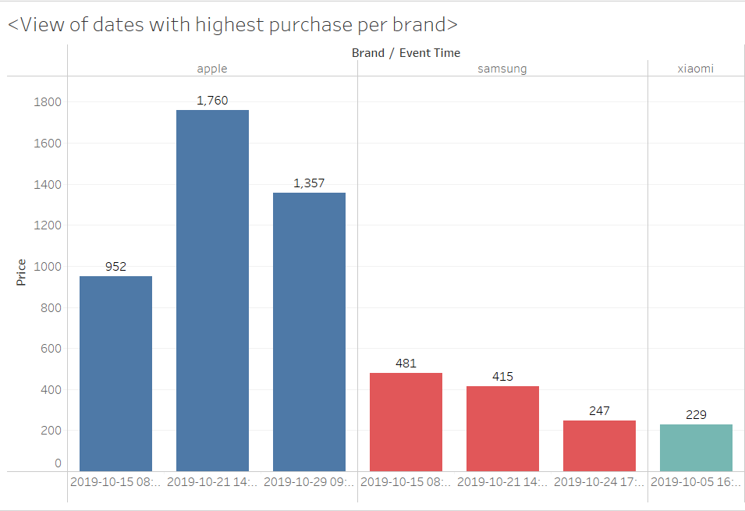
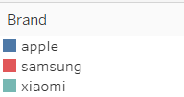
Time Visualization

Slide 10
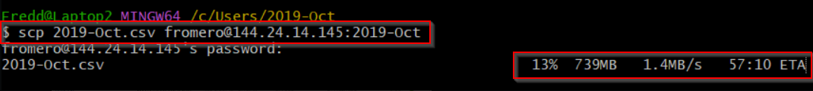
Challenges
We had trouble loading the data to Hadoop
Eventually we use the SCP command to upload the data
Our data did not have any Geo-spatial visualization, so we used Time/Tempo visualization

Slide 11
Conclusion
Wide variety of brands and item types that contribute to this dataset
Electronics are the most popular item
Apple is the top brand
People tend to view items or put them in their shopping cart rather than buying them
We can infer that people could be window shopping, waiting for a sales, or just be low in cash

Slide 12
References
https://www.kaggle.com/datasets/mkechinov/ecommerce-behavior-data-from-multi-category-store
https://github.com/jbarba2/CIS-4560-GROUP-4

